Slide 1
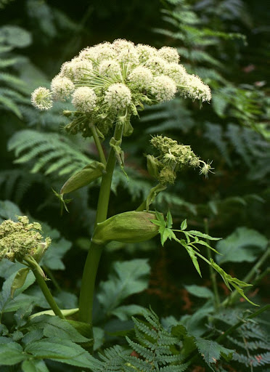
Woodland Angelica
What it is and how to control it
© FRANZ XAVIER, WIKI COMMONS

Slide 2
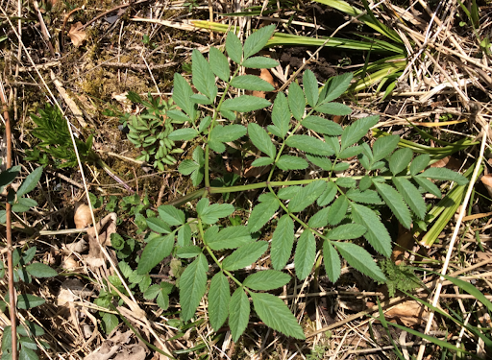
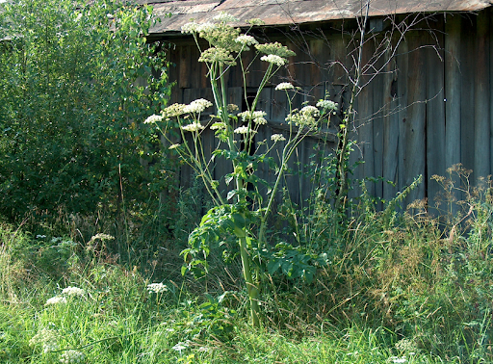
Woodland Angelica Angelica sylvestris
Leaves (1st year)
First introduced by French settlers in 1600’s or 1700’s
and has spread to NB, PEI, Quebec, and Ontario.
Description:
Large biennial (grows 1st year, flowers 2nd, then dies)
Member of the carrot family
1-2 m tall when flowering
Flowers July to September.
Small, fragrant white to pale-lilac flowers born on thick bamboo-like stalks
Habitat:
Any land that isn’t mown, grazed, or ploughed (ditches, hedgerows, marshes, fields, and woodlands).
Prefers moist soil, but isn’t fussy—tolerant of full sun, full shade, drought, and acidic soils.
(Nova Scotia Invasive Species Council, 2023)
Flowers (2nd year) similar to Queen Anne’s Lace, but with globe-like formations
When flowering, stands up to 2 m tall

Slide 3
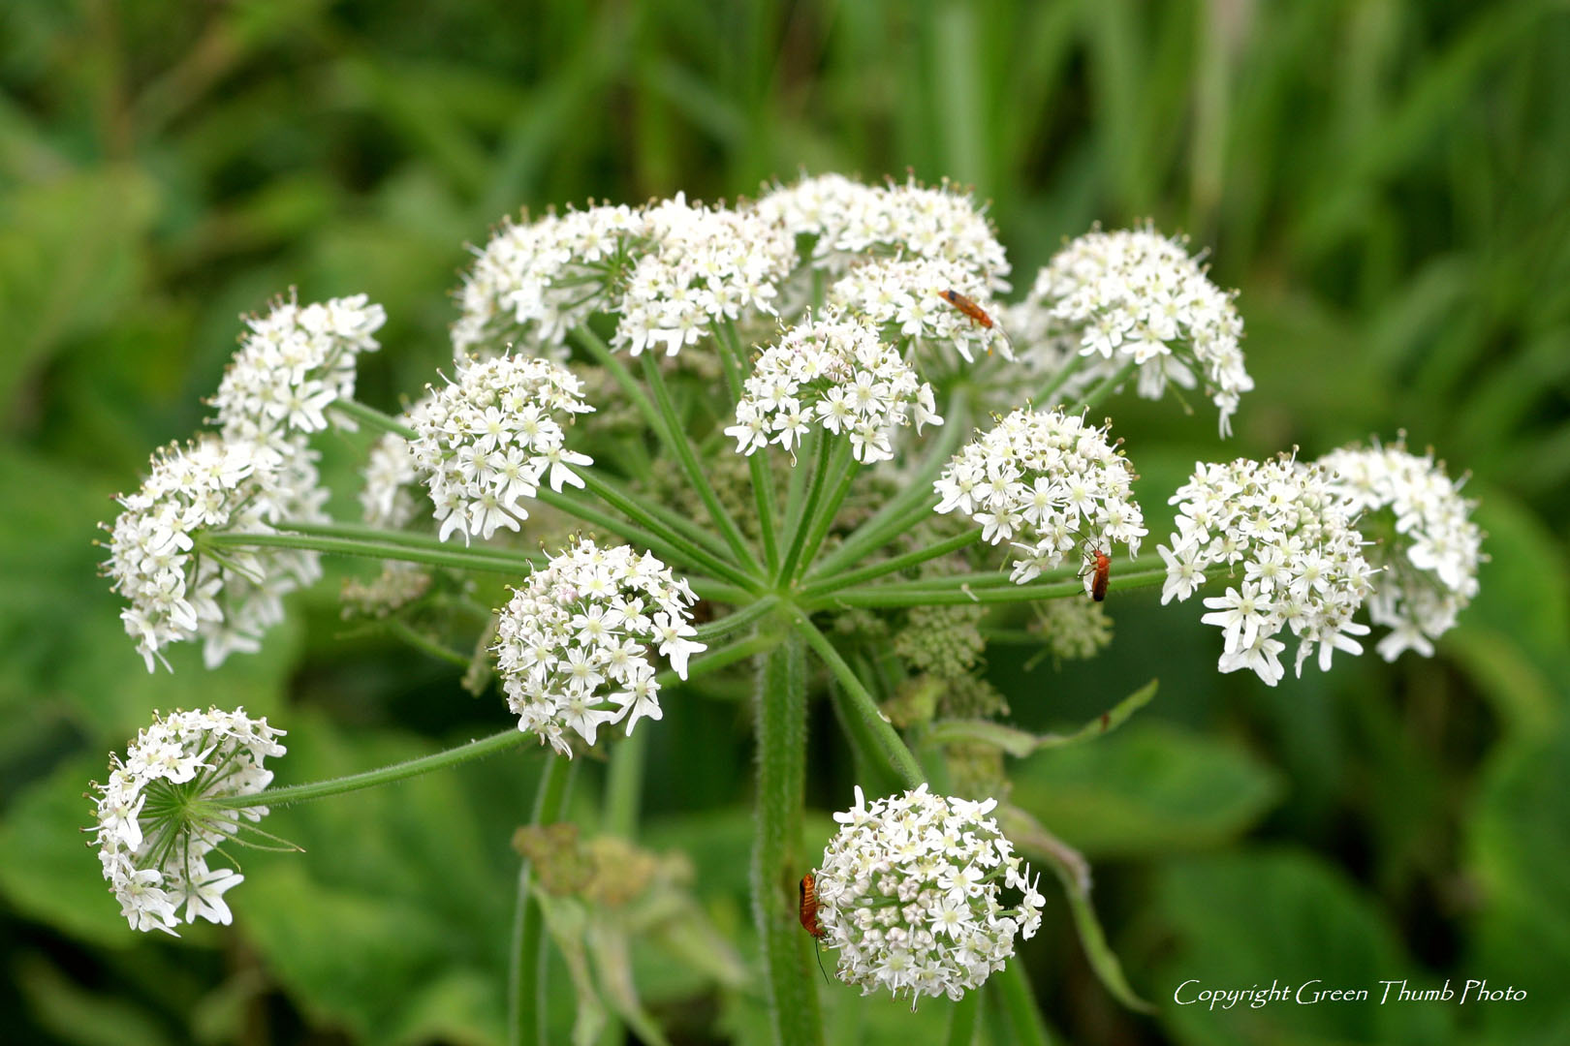
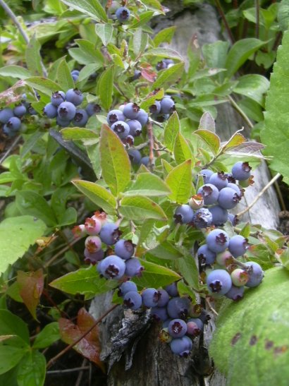
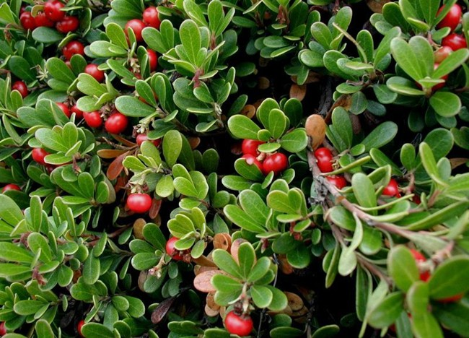
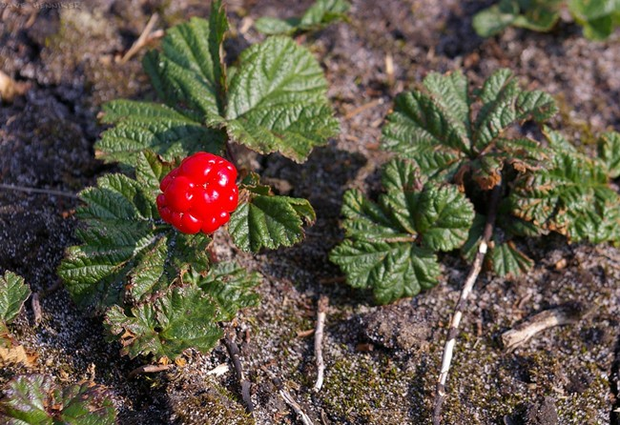
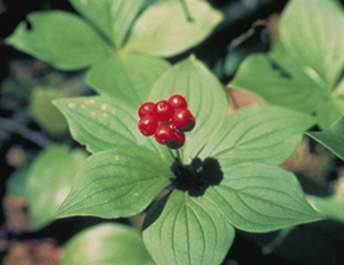
What impacts does Woodland Angelica have on the environment?
Shades out competitors (other native plants and wildflowers).
Pollinators focus more on the angelica and less on other species (Nova Scotia Invasive Species Council, 2023), which can lead to a reduction in wild berries (bunch berries, bearberries, cloudberries, blueberries) and other native species.

Slide 4
How to stop the spread of Woodland Angelica Mow it, dig it, pull it, or behead it*.
Mow fields each growing season (before the plant goes to seed).
Weed or whack your roadside drains.
Dig the plant out (or pull it right out when the soil is wet with rainwater).
*Cut off the flowers of 2nd year plants using hedge-clippers, sicateurs, or a machete. Clippers are the fastest.
Graze animals on it.

Slide 5
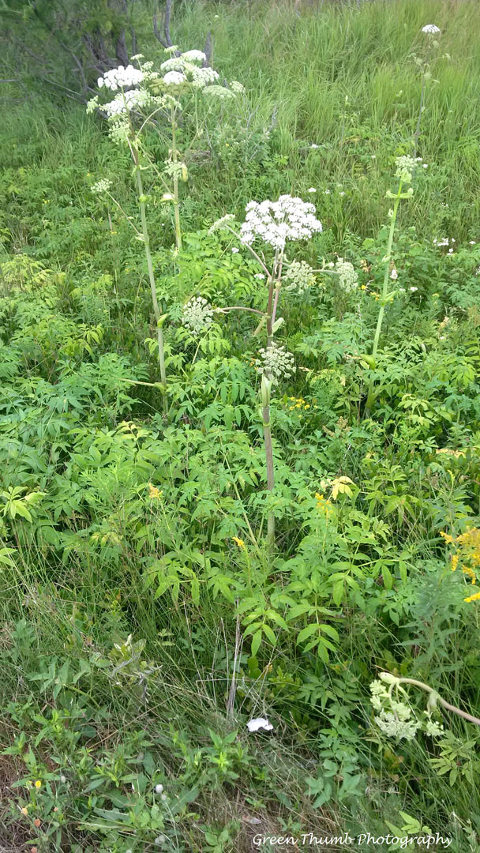
* For those who wish to control angelica through flower removal:
Although the word comes from the Greek for “archangel” (Jekkas, 2023), Angelica can be a bit of a Medusa—if one flowering bract is cut off, a new one will start to flower somewhere else.
Therefore, flower removal must be performed more than once per flowering season to stop replacement flowers from going to seed.
Replacement buds and flowers will appear lower to the ground and will be smaller after each cut—so stay vigilant and don’t give up. It’s good exercise anyway.
RE Black Bags: If you have a large area of flowering angelica to cover, don’t worry about bagging it all, which is time-consuming and takes up space. So long as the flowers haven’t already turned into seeds (i.e. you are cutting flowers, not seed heads), they won’t germinate. Just let them drop.

Slide 6
But is Angelica dangerous?
Some websites claim that the whole plant is edible, others that its juice will burn your skin if cut on a hot day.
  According to Sr. Agricultural Representative of the Dept. of Agriculture, Gary Kozierl, “[Angelica] is not a toxic plant like some other similar looking ones (hogweed, wild parsnip, hemlock) and can be pulled or burnt with no toxic effects […] but I would agree with the recommendations to take precautions primarily due to misidentification of what is being pulled – it looks so similar to other more toxic plants that it is easy to misidentify and there may be other species mixed in.” (Kozierl, personal communication, Oct. 22, 2023)
      IN SHORT, if you are unsure or nervous, just wear gloves.

Slide 7
Suggestions for the Municipality
Awareness: Most locals know what angelica looks like but may not know that its spread is harmful to the ecosystem or how to get rid of it.
  Ideas for growing awareness:
  An article in Richmond Reflections.
  An invasive plant webpage on the municipality’s website.
Community Weeding Events & Schemes: Event-based “Speed Weeding” or the adoption of a short stretch of road to keep clear of angelica.
Summer Internships: The creation of an Invasive Weed Awareness Officer Summer Internship for high school students (good for university applications, too).
Rent-Some-Sheep: Temporary sheep-grazing on angelica-overrun fields/areas.

Slide 8
References
All about Herbs: Angelica (Angelica Archangelica). (n.d.). Jekka’s. Retrieved
    November 19, 2023, from https://www.jekkas.com/blogs/jekkas-blog/:~:text=A%20word%20of%20caution,%20like,cause%20burns%20to%20the%20skin.
Bunchberry Berries (Cornus canadensis) in Nova Scotia. (n.d.).
    https://www.northernbushcraft.com/topic.php?name=bunchberry&region=ns&ctgy=edible_berries
PEI Invasive Species Council - Woodland Angelica. (n.d.). https://peiinvasives.com/woodland-angelica/#what-it-does-in-the-ecosystem
Woodland Angelica. NS Invasive Species Council. (2023, April 24).
https://nsinvasives.ca/woodland-angelica/

